Slide 1
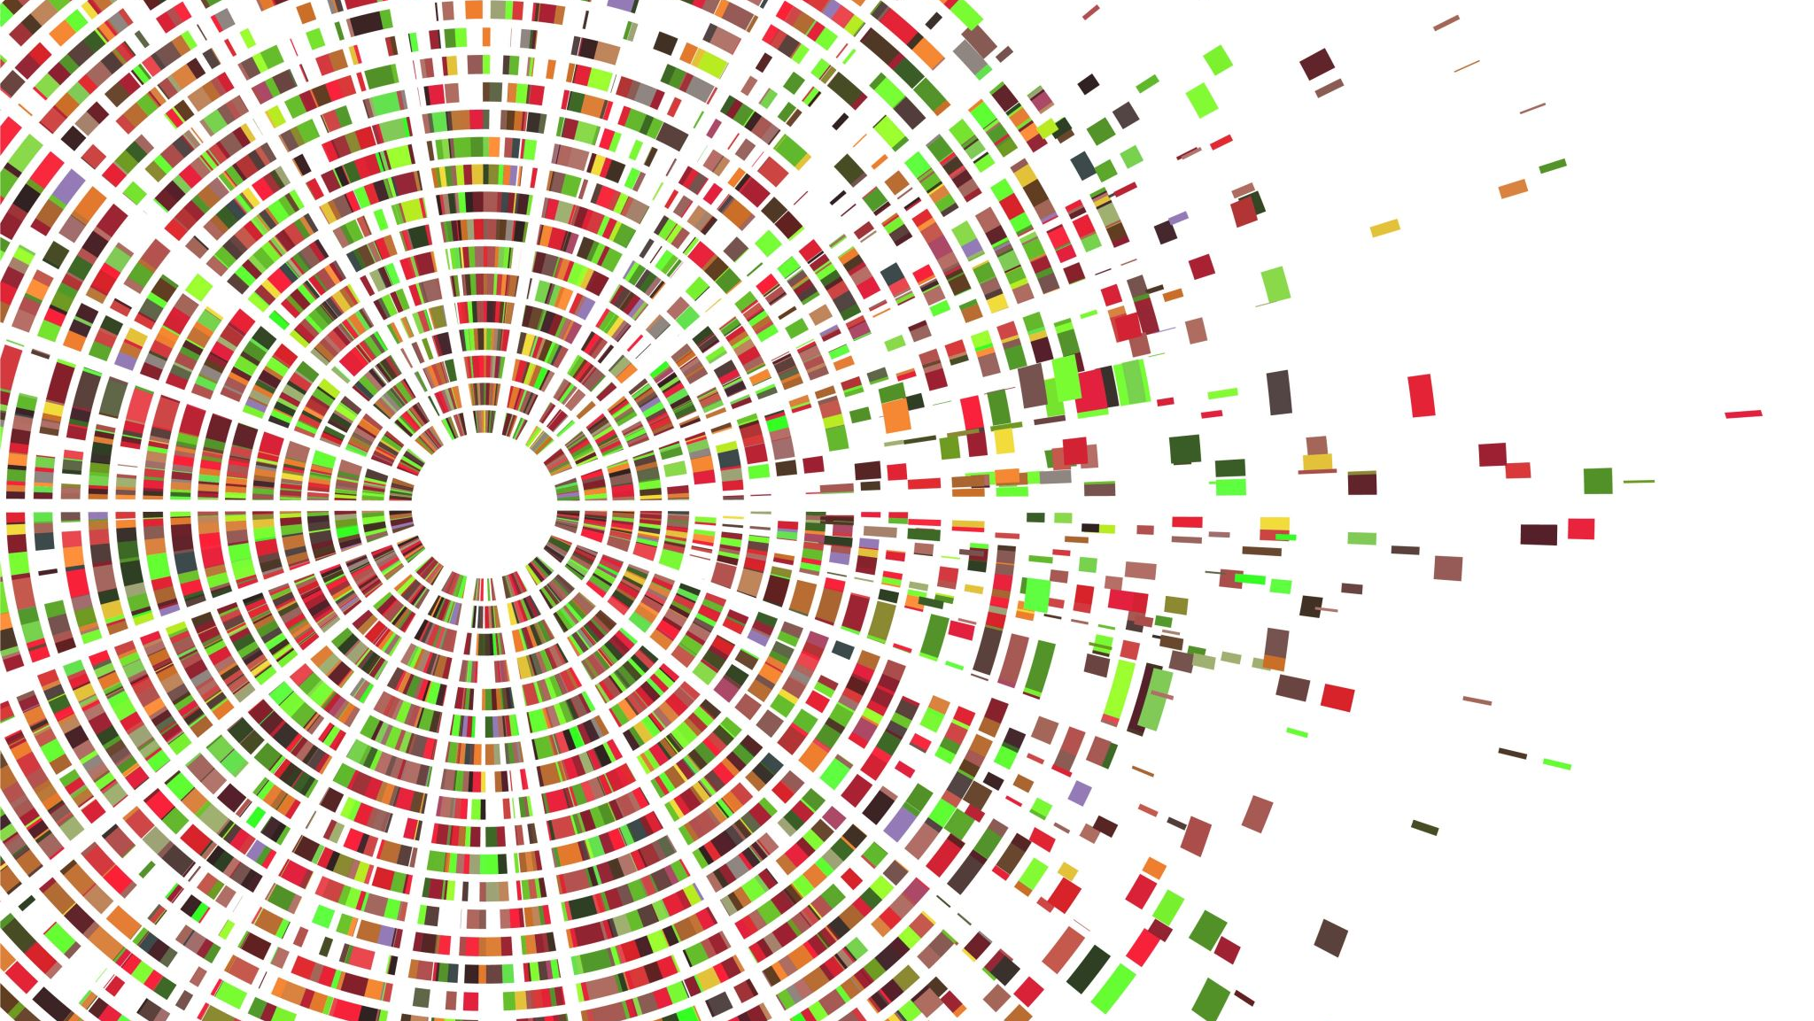
The Rise of Fake News in the Political Scene
By Michael Mahoney

Slide 2
Presentation Overview

Slide 3

Who is This Presentation For

